Slide 1
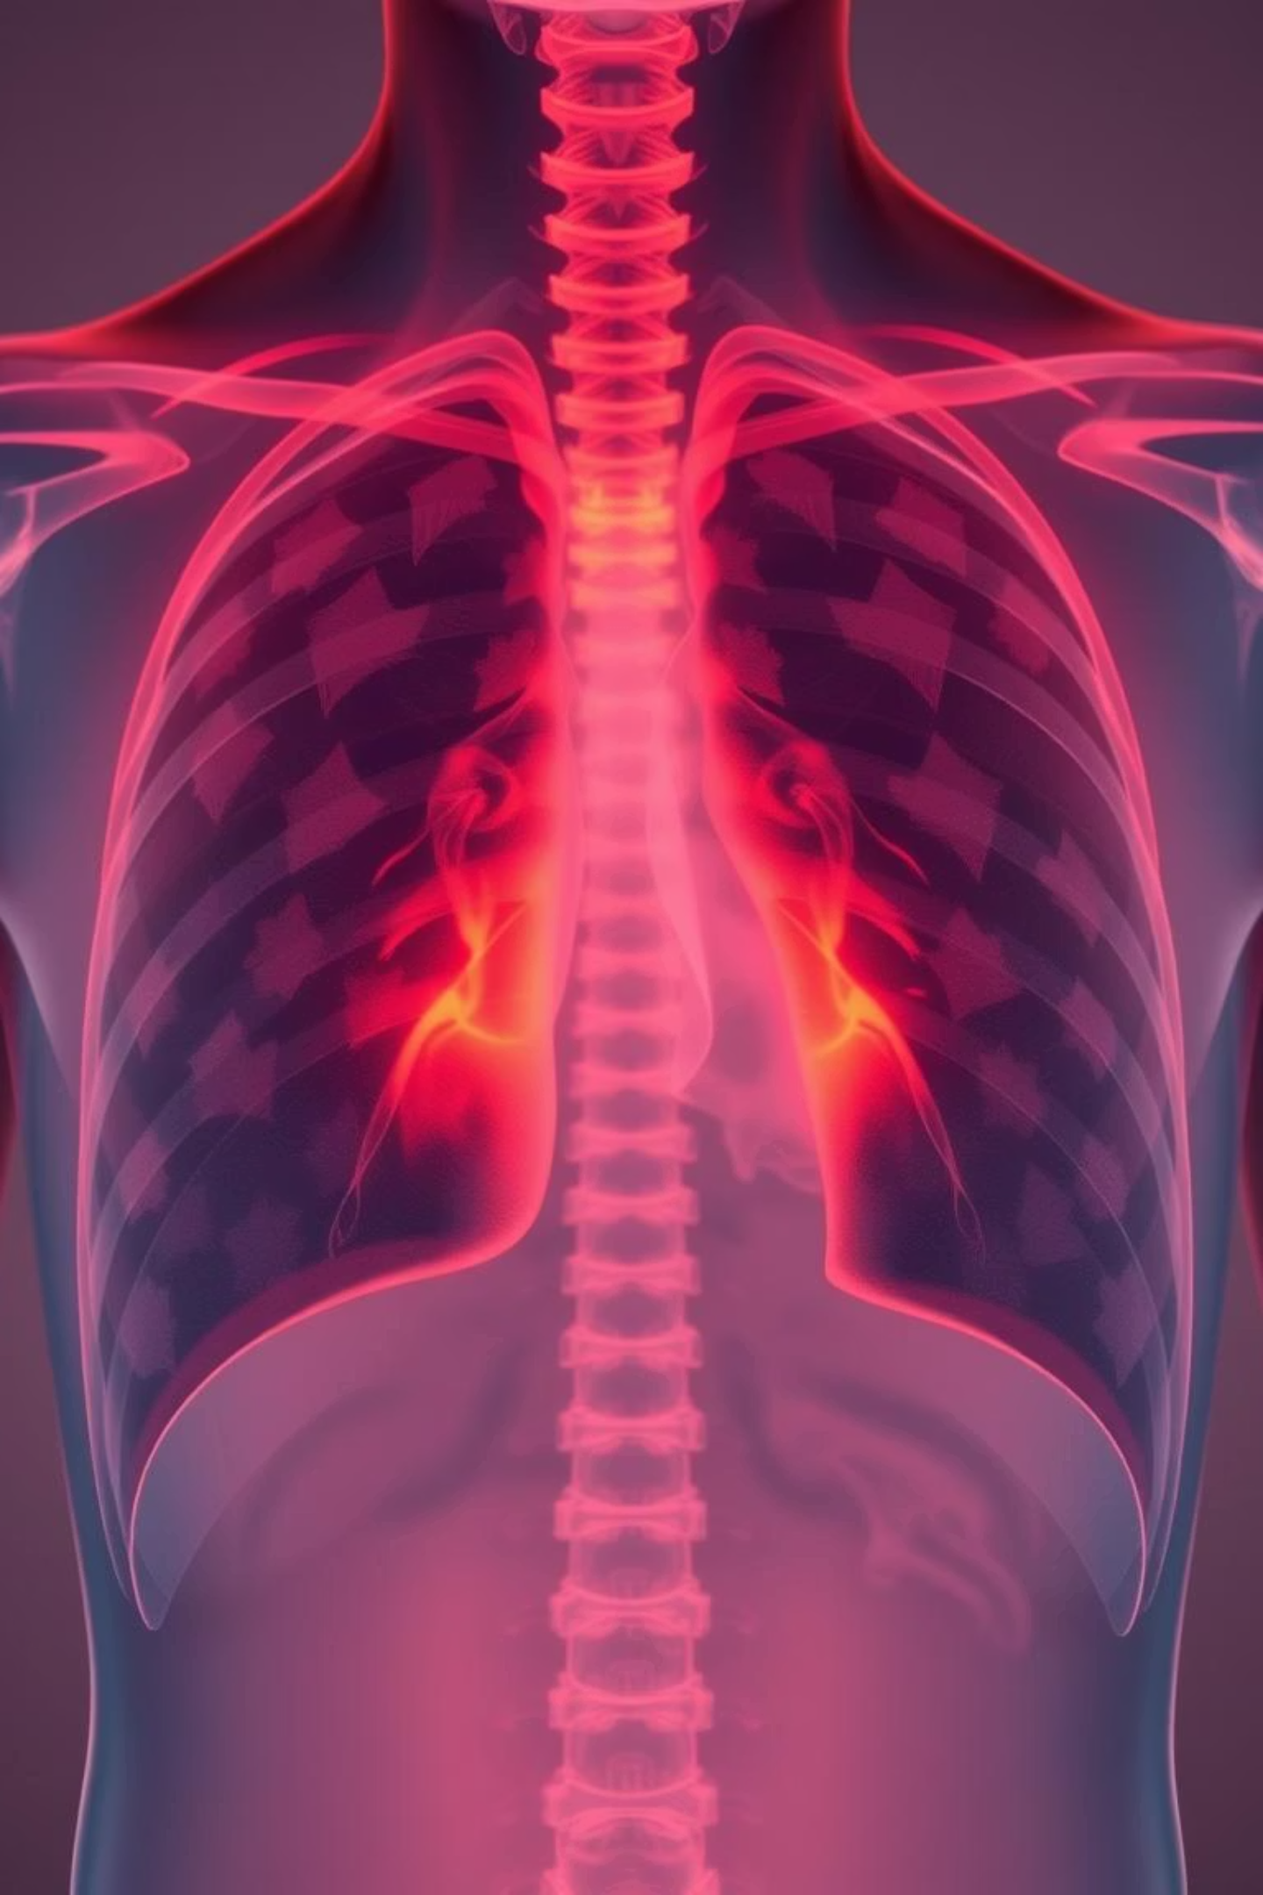
Pneumonia Detection using Convolutional Neural Networks
Deep Learning Project using Chest X-ray Images
By Aishwarya S | April 2025

Slide 2



Project Overview: AI for Early Detection
Objective
Approach
Deliverable
Automate pneumonia detection from chest X-ray images, aiding early diagnosis and treatment.
Leverage Deep Learning, specifically a Convolutional Neural Network (CNN) with MobileNetV2 for robust image analysis.
A user-friendly web application for real-time, accessible pneumonia detection.

Slide 3
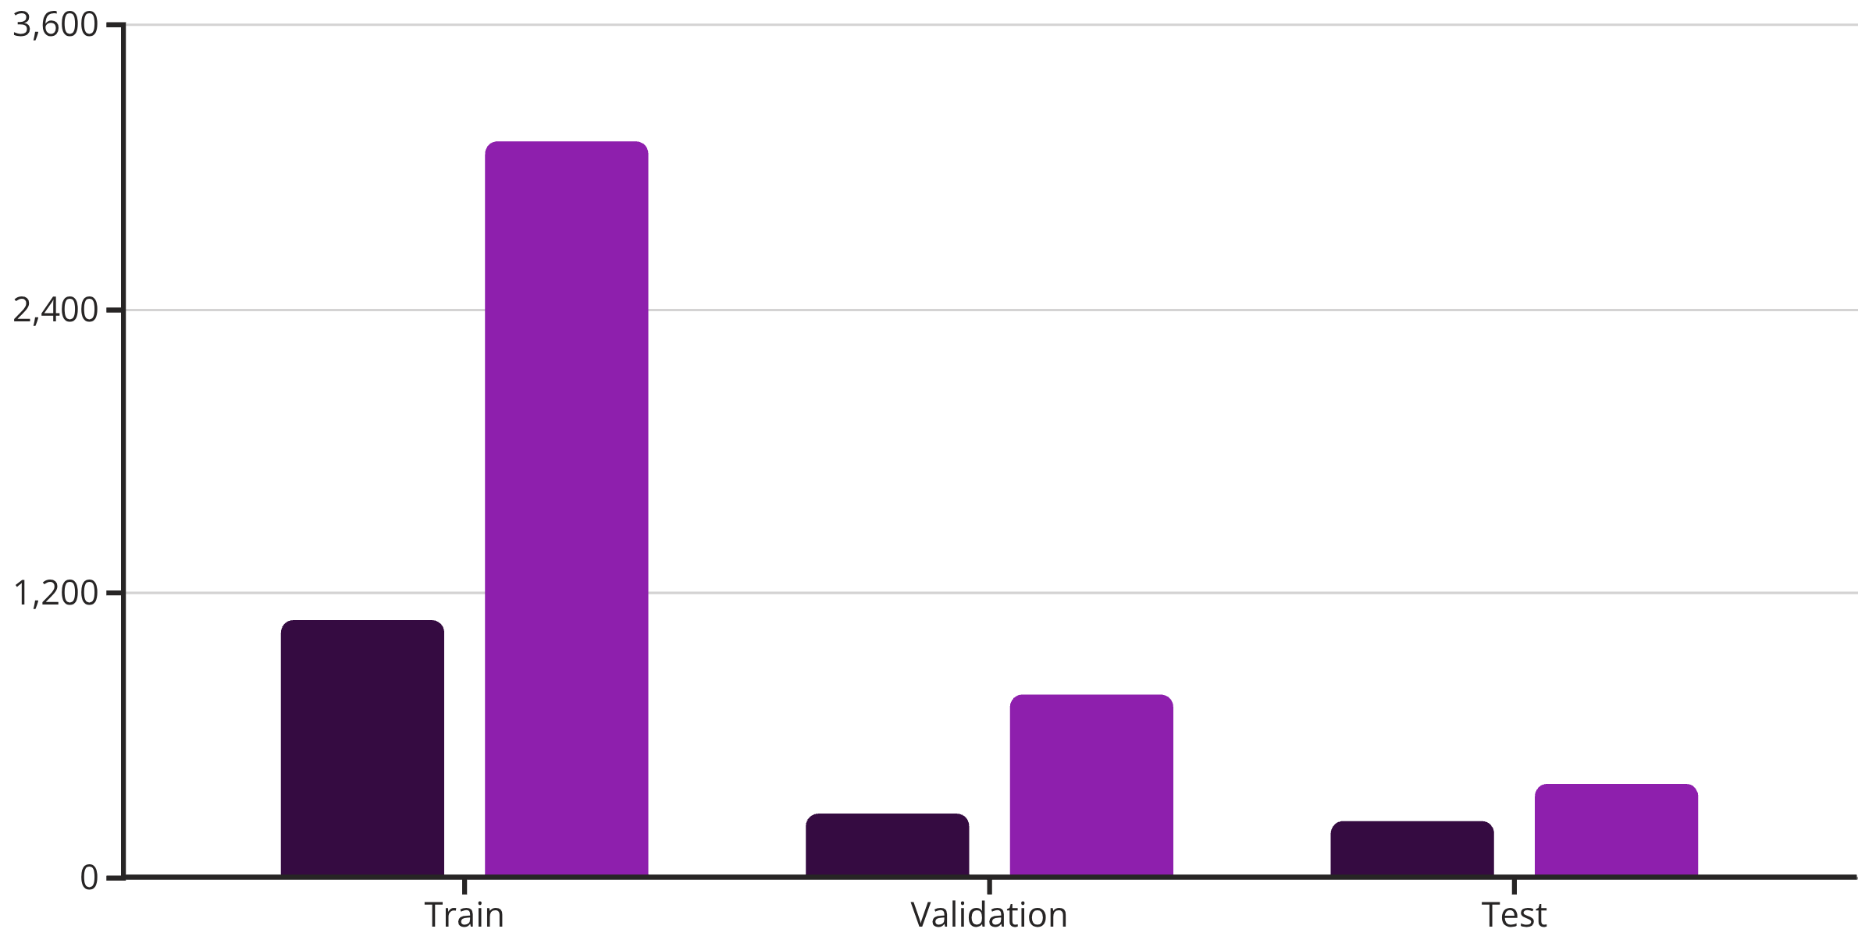
Robust Dataset for Training
The model was trained and validated on a comprehensive chest X-ray dataset from Kaggle, ensuring a diverse representation of both normal and pneumonia cases.
Normal Cases
Pneumonia Cases
All images were consistently resized to 224x224 pixels for uniform input to the neural network.

Slide 4


Model Architecture & Training Regimen
Loss Function
Categorical Crossentropy, ideal for multi-class classification.
Model
Leveraged MobileNetV2 with transfer learning for efficient feature extraction.
Optimizer
Adam optimizer for adaptive learning rate optimization.
Epochs
Libraries
Trained for 10 epochs with EarlyStopping to prevent overfitting.
Built with TensorFlow and Keras for deep learning, Streamlit for deployment.

Slide 5
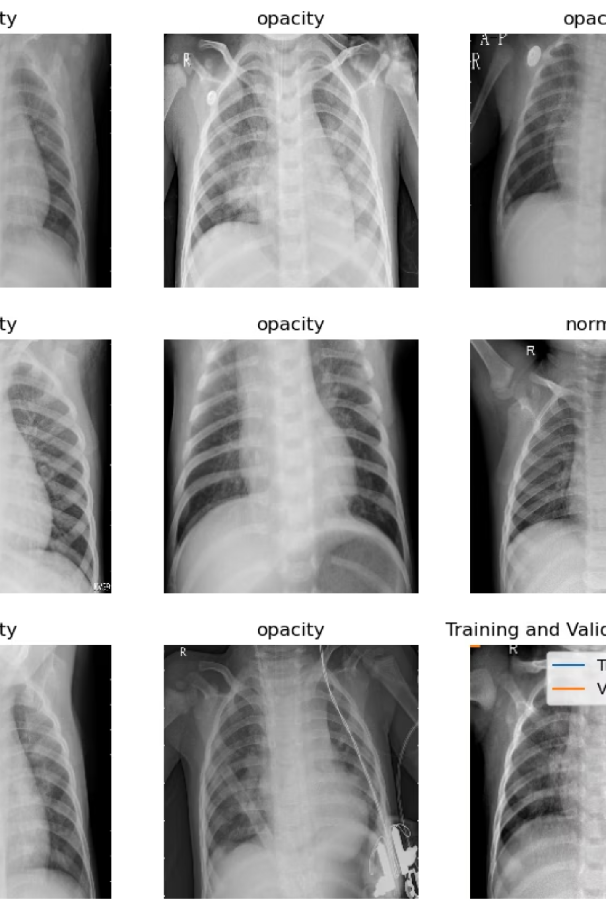
Sample Predictions: Visualizing AI Diagnosis
The model accurately categorizes X-ray images, providing immediate visual feedback on its predictions. This slide showcases examples of the model's output, demonstrating its ability to distinguish between normal and pneumonia cases.

Slide 6
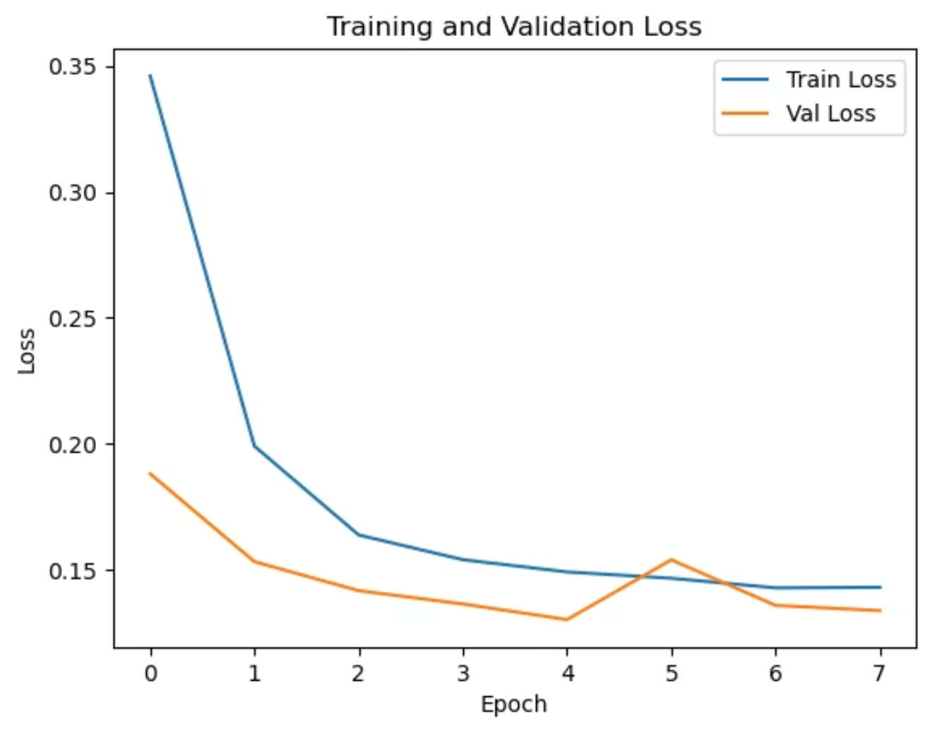
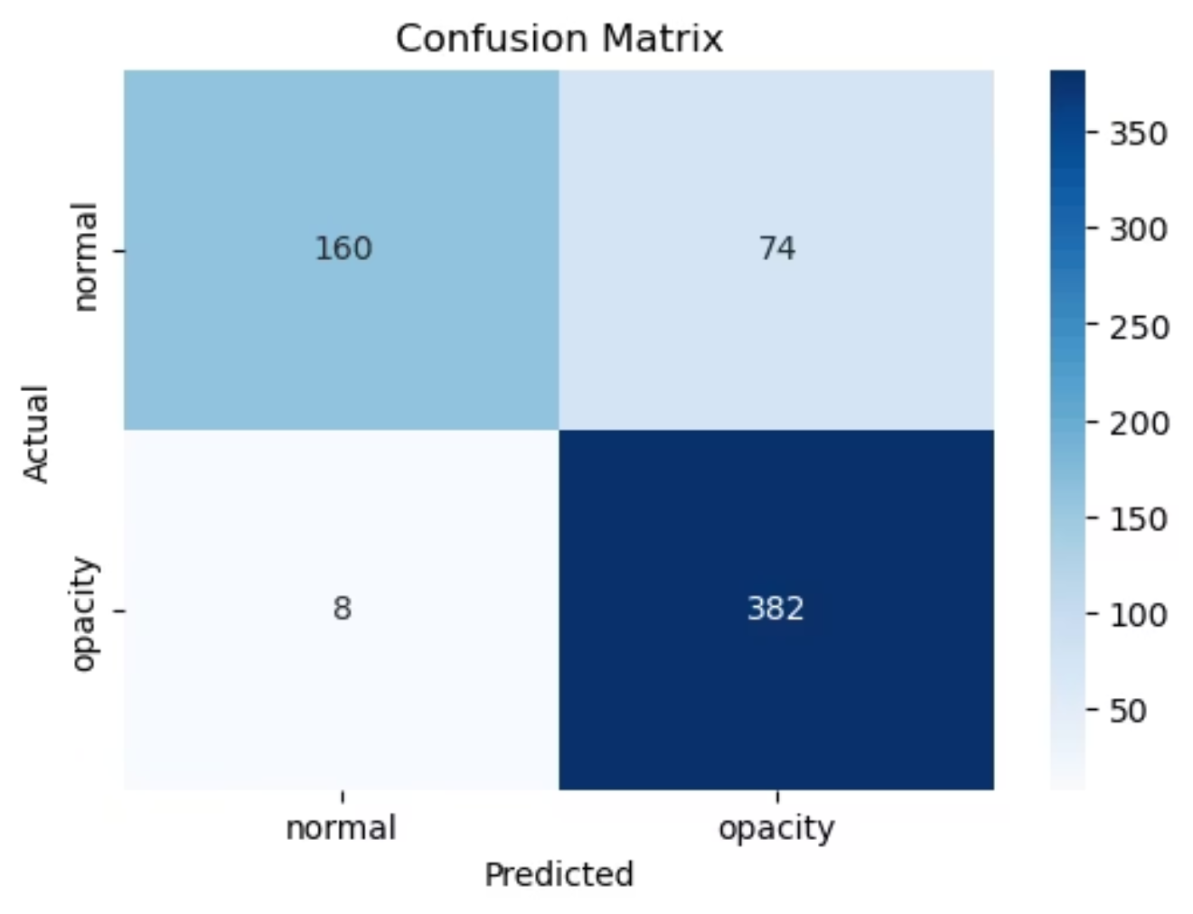
Model Evaluation: Performance Metrics
The model's performance was rigorously evaluated, demonstrating high accuracy and robust generalization capabilities on unseen data.
Accuracy & Loss
Confusion Matrix
The training curves indicate stable learning and convergence, with a clear reduction in validation loss over epochs.
The confusion matrix highlights strong predictive power, especially for pneumonia cases, with minimal false negatives.

Slide 7


Deployment & Future Enhancements
Current Deployment
Future Scope
A Streamlit web application allows for easy local or online usage, making the model accessible.
Implement Grad-CAM for model explainability.
Develop a robust Flask-based API for broader integration.
Explore hosting on Streamlit Cloud or HuggingFace for scalability.
Focus on improving recall for the NORMAL class to balance performance.

